Slide 1

DSAI4205 Big Data Analytics
Assignment 1

Slide 2

Q1: Distributed Sensor Calibration with Dask
Utilize map_blocks()to apply a function across all blocks of a Dask array
Create a $1000 × 1000$ Dask array of floats, chunked into $100 × 100$ blocks.
Use a Normal (Gaussian) Distribution for sensor readings (mean=10, std=1.0).
Use a Uniform Distribution for the weights (0.9 to 1.1)
Write a function that multiplies the entire data_block by the single scalar value in weight_block.
apply_calibration(data_block, weight_block, block_info=None)
0
1
100
999
weights
0
7.54846726 | 9.17531375 | … | 10.49257604 | … | 9.81685118
9.61848144 | 10.20097405 | … | 11.98946141 | … | 8.89440492
… | … | … | … | … | …
9.48876980 | 10.74219322 | … | 9.558427449 | … | 11.3993321
… | … | … | … | … | …
9.32135686 | 9.585213610 | … | 9.805154873 | … | 10.3585955
0.99945196 | 1.08744532 | … | 1.05384327
1.09210382
… |  |  | …
0.94626086 | 0.96684996 | … | 0.91652553
1
10
100
999
10

Slide 3
Q1: Distributed Sensor Calibration with Dask
To understand how map_blocks()works,
Add a global counter or a print statement inside your function.
Run map_blocks without the dtype argument,
Run map_blocks with the dtype argument.
Why does the first version execute your function more times than the second?
How to adjust the map_blocks function to run exactly 100 times ?
Explain why Dask allows you to pass two arrays of different total shapes (1000,1000) vs (10,10) into the same map_blocks call.
Please justify your answer by using block_info and provide examples to support your answer
What if the Weights array was a 1D array of 100 elements ?
Keep in mind that map_blocks is the only function available for you to use in order to complete this question.

Slide 4
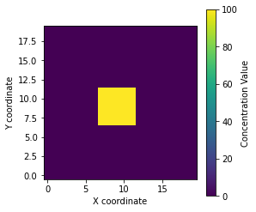
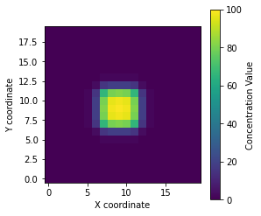
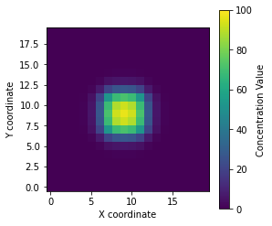
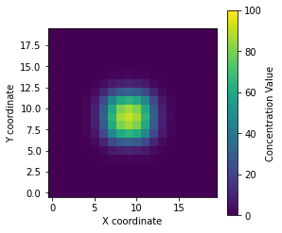
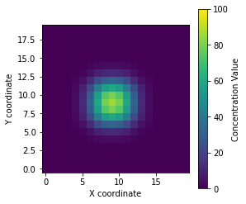

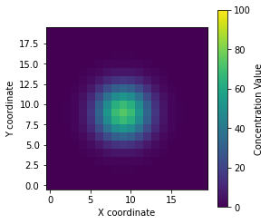


Q2: Parallel Diffusion Simulation
Question 2: (80%)
Understand the usage of map_overlap()
Utilize map_overlap()to apply a function that updates the values of each cell based on the values of its neighbors to simulate diffusion in the $(20 × 20)$ grid.
Show the results by plotting the graph using matplotlib for every 5 iterations (include the initial setting)
Initial version
5th Iteration
10th Iteration
15th Iteration
20th Iteration
25th Iteration
30th Iteration
35th Iteration

Slide 5
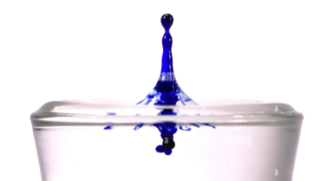
Q2: Parallel Diffusion Simulation
Imagine you have a large grid representing a beaker of still water. In the middle, you gently drop a single drop of ink (a "hot spot" of high concentration).
Initially: One spot has a value of 100 (pure ink), and everything else is 0 (Clear water).
Over Time: The ink particles move randomly. They travel from where there are many particles to where there are fewer particles.
Eventually: The ink spreads out until the entire beaker has the same, low-level concentration. This state is called equilibrium, and the water is a uniform blue.

Slide 6
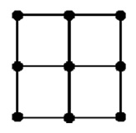
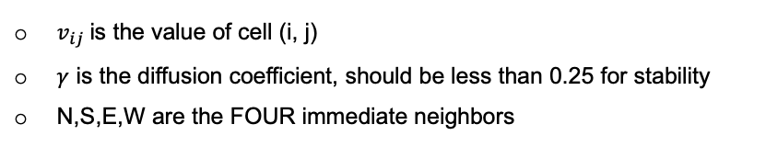
Q2: Parallel Diffusion Simulation
The simulation is initialized on a two-dimensional grid of squares
We are considering a grid size of 20 x 20 for our assignment.
To simulate spreading, we apply a simple rule to every cell in the grid simultaneously
To calculate the value of a cell (Center) for the next second of time, we look at its four immediate neighbors: North (N), South (S), East (E), and West (W).
The change in the center cell is determined by the net difference between it and its neighbors:
North
center
West
East
$$v_{i,j}^{next}=v_{i,j}^{current}+γ × (N+S+E+W−4 × v_{i,j}^{current})$$
$v_{ij}$is the value of cell (i, j)
$γ$ is the diffusion coefficient, should be less than 0.25 for stability
N,S,E,W are the FOUR immediate neighbors
South

Slide 7

Visualization Example
E.g., $γ=0.05$
Initial Setting
0 | 0 | 0 | 0 | 0
0 | 0 | 5 | 0 | 0
0 | 5 | 80 | 5 | 0
0 | 0 | 5 | 0 | 0
0 | 0 | 0 | 0 | 0
0 | 0 | 0.25 | 0 | 0
0 | 0.5 | 8 | 0.5 | 0
0.25 | 8 | 65 | 8 | 0.25
0 | 0.5 | 8 | 0.5 | 0
0 | 0 | 0.25 | 0 | 0
0 | 0 | 0 | 0 | 0
0 | 0.5 | 8 | 0.5 | 0
0 | 8 | 65 | 8 | 0
0 | 0.5 | 8 | 0.5 | 0
0 | 0 | 0 | 0 | 0
0 | 0 | 0 | 0 | 0
0 | 0 | 0 | 0 | 0
0 | 0 | 100 | 0 | 0
0 | 0 | 0 | 0 | 0
0 | 0 | 0 | 0 | 0
0 | 0 | 0 | 0 | 0
0 | 0 | 0 | 0 | 0
0 | 0 | 80 | 0 | 0
0 | 0 | 0 | 0 | 0
0 | 0 | 0 | 0 | 0
0 | 0 | 0 | 0 | 0
0 | 0 | 5 | 0 | 0
0 | 5 | 65 | 5 | 0
0 | 0 | 5 | 0 | 0
0 | 0 | 0 | 0 | 0
0 | 0 | 0 | 0 | 0
0 | 0 | 8 | 0 | 0
0 | 8 | 65 | 8 | 0
0 | 0 | 8 | 0 | 0
0 | 0 | 0 | 0 | 0
t = 0
t = 1
t = 2
100 + 0.05*(0-4*100) = 80
0 + 0.05*(100-0) = 5
80 + 0.05*(20-4*80) = 65
5 + 0.05*(80-4*5) = 8
0 + 0.05*(10-4*0) = 0.5
0 + 0.05*(5-4*0) = 0.25
Write a function that compute and update the diffusion value for each cell.
def update_diffusion(block=None, core_dims=None, gamma=0.05, block_info=None):
In this function, you must utilize a nested for loop to update each element. No marks will be awarded if you do not use a nested for loop for this section.

Slide 8
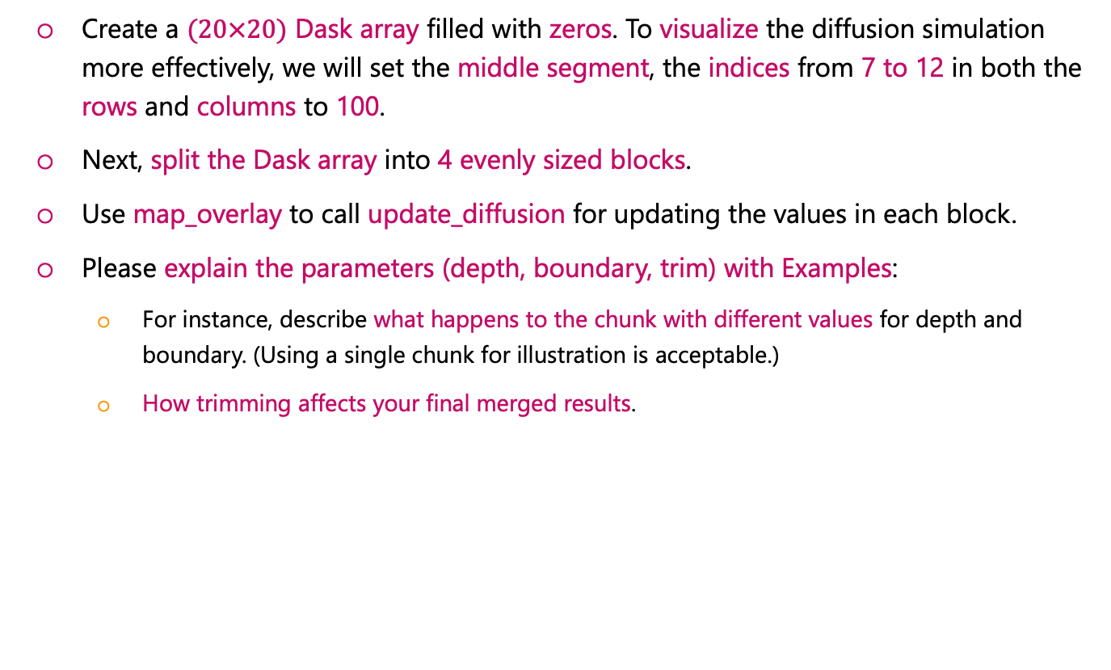
Instructions for Q2
Create a $(20×20)$ Dask array filled with zeros. To visualize the diffusion simulation more effectively, we will set the middle segment, the indices from 7 to 12 in both the rows and columns to 100.
Next, split the Dask array into 4 evenly sized blocks.
Use map_overlay to call update_diffusion for updating the values in each block.
Please explain the parameters (depth, boundary, trim) with Examples:
For instance, describe what happens to the chunk with different values for depth and boundary. (Using a single chunk for illustration is acceptable.)
How trimming affects your final merged results.

Slide 9
Submission
Upload the Jupyter notebook file to Blackboard
Deadline: 24 Feb 23:55
Submitted after the deadline will be regarded as one full day late.
A 10% deduction will apply for each 24-hour period thereafter.
We will not accept any homework that is more than three days late.
The work that you submit for assessment must be YOUR OWN WORK
The work must be original in the sense that it is your intellectual creation.
Your submission cannot be a copy/version of other people’s work or AI-generated material.
ZERO mark will be given if any misconduct is caught evidently

Slide 10

Any Questions?

